Slide 1

Physical activity, nutrition, AND BMI I
Presented by: Seleiye Tiemo
Course Name: DASC 4850
Professor Name: Jason Satel
Date: 4/19/2026

Slide 2

Initial thoughts
After reading the project requirements, I received a rush of ideas for the project. I thought about whether or not fat loss and muscle gain can happen at the same time, and how to measure that over a period of time. I couldn't find datasets because most of them were behind paywalls. I decided to develop something easier to find data on, so I am going to examine the relationship between physical activity, BMI, and nutrition.

Slide 3

Research questions
To what extent are physical activity level and daily dietary intake associated with BMI among adult NHANES participants from the 2015–2016 and 2017–2018 cycles?
These questions are tenable to the project because:
This question is specific and testable.
T examines whether a small set of lifestyle variables can help explain BMI.
It aligns well with the NHANES dataset.

Slide 4


PROJECT WORKFLOW
Merge NHANES datasets.
Clean and prepare the data.
Perform exploratory data analysis.
Compare BMI by activity group using a t-test.
Build a regression model.
Interpret the results and limitations

Slide 5




Data Source: 1. NHANES 2015-2016 and 2017-2018 2. Files used: DEMO, DR1TOT, PAQ, BMX 3. Datasets merged using SEQN Outcome Variable: 1. BMI Predicator Variables: 1. Age 2. Gender 3. Activity group 4. Calories 5. Protein 6. Carbohydrates 7. Fat
DATA SOURCE AND VARIABLES

Slide 6
Data Preparation
The data cleaning and preparation process:
Selected only the variables relevant to the research question.
Merged Nhanes files using SEQN.
Restricted the sample to adults age 18 and older.
Removed missing values in key varables
Created activity groups for the t-test and regression model

Slide 7

Activity Group Definition
Defining Activity Groups
Active: participants who reported either moderate or vigorous activity
Not Active: participants who reported no to both moderate and vigorous activity
Why this definition works
It is simple
It is clear
It is reproducible
Important limitation
This is a coarse grouping
It does not capture exercise frequency or full intensity
It is based on self-reported activity

Slide 8
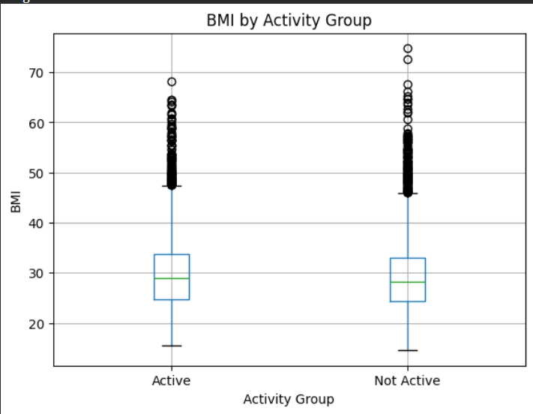
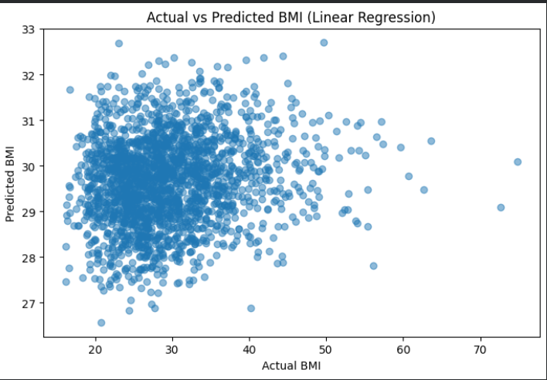
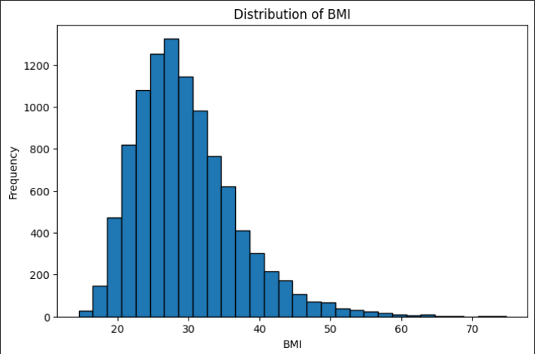
Exploratory Data Analysis
Main observations:
BMI showed a broad distribution across participants.
BMI differed somewhat across activity groups.
The visual relationship between calories and BMI appeared

Slide 9




BMI Differences by Activity Group: 1. I used an independent samples t-test to compare BMI between Active and Not Active participants. 2. The activity groups were based on self-reported moderate or vigorous activity Results: 1. Mean BMI (Active): 29.939830692424568 2. Mean BMI (Not Active): 29.34665700308027 3. T-statistic: 4.102133353427426 4. P-value: 4.127000212838253 Interpretation: 1. There is a statistically significant difference in BMI between the two activity groups. 2. Because the activity variable is simplified, the results should be interpreted with caution.
T-TEST RESULTS

Slide 10
Goal: 1. To examine whether BMI can be explained or predicted using a small set of demographic, activity, and dietary variables. Model used: 1. Linear Regression Predicators: 1. Age 2. Gender 3. Activity group 4. Calories 5. Protein 6. Carbohydrates 7. Fat I kept linear regression as the final model because Ridge regression did not meaningfully improve performance.
REGRESSION MODEL

Slide 11

MODEL PERFORMANCE
Final Model: Linear Regression
RMSE = 7.17
MAE = 5.49
R-SQUARED = 0.021
Interpretation:
The model explains about 2.1% pf the variation in BMI
This indicates very low explanatory power.
The selected variables are not enough to meaningfully explain BMI on their own.

Slide 12
Coefficients and Multicollinearity
Coefficient Interpretation with Caution:
Some regression coefficients were not intuitive
This is expected because calories, protein, carbohydrates, and fat are strongly related to each other.
This creates multicollinearity
Multicollinearity makes it difficult to isolate the effect of each dietary variable.
Interpretation apporach:
I focused on the overall pattern of results rather than overemphasizing any single dietary coefficient.
The coefficients should be interpreted cautiously.

Slide 13
LIMITATIONS
Project Limitations:
The activity variable is a simplified binary measure.
Physical activity data are self-reported.
Dietary intake reflects short-term behaviour from a single day.
Important predicators of BMI were not included in the model.
BMI does not distinguish between fat mass and muscle mass
These limitations help explain why the model had weak predictive power

Slide 14
Master Program Project reform
If this were a master's-level project, I would expand the analysis in several ways:
Use a more detailed measure of physical activity, including frequency, duration, and intensity instead of a simple binary grouping
Reduce or restructure the dietary variables to address multicollinearity more formally
Incorporate additional predictors such as waist circumference, socioeconomic variables, health conditions, or environmental factors
Use repeated or longer-term dietary and behavioural measures rather than relying on a single day of intake.
Compare multiple modelling approaches and evaluate whether more advanced methods improve prediction in a meaningful way
Explore causal questions more carefully rather than focusing mainly on association and interpretation.
At a master's level, the goal would be to build a richer and more theoretically grounded model of BMI while still maintaining interpretability

Slide 15
CONCLUSIONS
The conclusions for the project is:
This project followed a complete workflow from data merging to interpretation.
The t-test and regression model were appropriate for the research question.
The regression results showed that BMI is not easily explained by a small set of self-reported lifestyle.
The most important result was not strong predication, but a clear understanding of the model's limitations
Final takeaway:
This project shows the importance of careful interpretation when using public health data to study complex outcomes like BMI.

